Slide 1
What you need to know when you want to reformulate with whole grains?
WHOLEUGRAIN SPRING SCHOOL
29 March 2022
Alfred Mar

Slide 2
Key issues - reformulation
  Use of whole grain → definition national or WGI
  Food safety
  Grain quality, flour quality
    Particle size
    Water binding, swelling
  National regulations for whole grain food (e.g. whole grain bread)

Slide 3
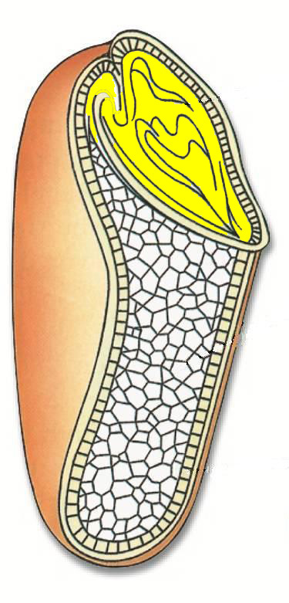
Whole Grain Ingredient
WGI Document May 2019
  Cereals and pseudocereals
  intact, ground, cracked, flaked or otherwise processed kernels (e.g. fermented, malted, sprouted)
  endosperm, germ and bran in the same relative proportions as in the intact kernel

Slide 4
  Food Safety – Importance of cleaning and peeling → removal of surface contaminants
  Distribution of Contaminants in grain kernels, e.g. Cadmium
  (Cit.: J. Begemann, Max Rubner Institute, Detmold, INGESA, 03.06.2016)

Slide 5
Definition of Whole grain
Int. Whole Grain Initiative
May 2019
Small losses of components that occur through processing methods consistent with safety and quality are allowed.
Removal of the very outer bran layer (parts of pericarp) is acceptable for minimising levels of undesirable substances such as bacteria, mycotoxins, agrochemicals and heavy metals → surface contaminants

Slide 6
Definition of Whole grain
Int. Whole Grain Initiative
May 2019
The maximum acceptable level of losses depends on the type of grain and local conditions and will therefore be kept open to local regulators (for wheat discussed 2% of grain weight or 10% of bran).
Processing incl. cleaning should not result in a >10 % reduction in the dietary fibre content as an indicator of the amount of beneficial components within the whole grain.

Slide 7
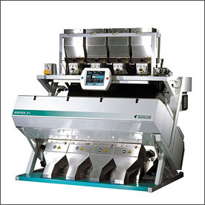
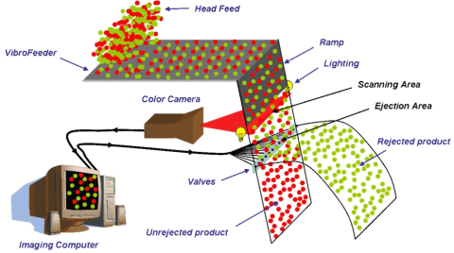
Contaminated kernels
Optical separation „Sortex“
Buhler comp. (CH)
Dark, spotted or light kernels scanned and ejected by air valves.

Slide 8
Grain quality, flour quality e.g. Whole grain bread
Overall objective: achieving consumer´s high acceptance
Wheat and rye: high baking quality to obtain a leavened crumb and good bread volume
Wheat: sufficient gluten amount and quality
Rye: adequate starch gelatinisation, enzymatic activity and arabinoxylan content
recombined whole grain flour → option to meet the needs

Slide 9
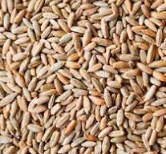
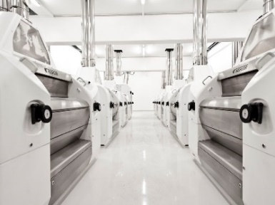
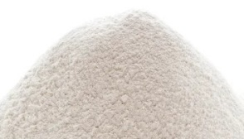
Milling – Whole grain
Traditional “straight milling”
Passage milling
fractions 1 to n
Recombined whole grain flour

Slide 10
Flour quality – particle size e.g. Whole grain bread
Basic decision and measures to achieve sensory quality standards
Whole grain visible → coarse meal, broken/cut or intact kernel → water amount, swelling process, softening of endosperm structure
Fine grade whole grain flour → particle size
  Recommendation
  60 % 100 to 300 μm, max. 20 % >300 μm

Slide 11
Formulation of whole grain product e.g. Whole grain bread
Priority: national regulation
Alternative: recommendation of WGI
  Example Whole Grain Bread Austria: min. 90 % WG of cereal product amount
  Comparison WGI: min. 50 % WG of dry matter
Amount of water → WG higher water binding ability
  Swelling process: time and temperature

Slide 12
Swelling process – water binding
Long time – low temperature e.g. up to 24 h and 30 °C
  E.g. yeastless spongedough, dough yield 200
  Hygienic risk, recommendation fermented dough (sour dough)
Short time – controlled temperature process
    “Cooked cereals”: dough yield up to 300
    Controlled heating up to 80 to 85 °C
    Optional rest at 65 °C – enzymatic digestion
    Holding max. temperature 10 to 20 minutes
    Controlled cooling down (very short time between 40 to 20 °C, avoiding development of mesophile microorganisms)

Slide 13
Summary
Based on national regulation or recommendation of WGI
High quality level of Whole Grain Food (bread, pasta, fine bakery ware, other cereal based products)
With high consumer´s acceptance
Care for Food safety
Use of milling products meeting the standards of specific quality (e.g. baking ability)
Utilize the higher water binding ability, swelling process with sufficient time and temperature

Slide 14
Many thanks for your attention

